Slide 1

WELCOME MEETING FOR INTERNATIONAL EXCHANGE STUDENTS
Erasmus Co-ordinator: Assist. Prof. Dušan Petrovič, Ph.D. International Office: Romana Hudin
February 2016

Slide 2
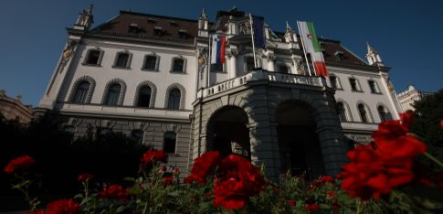
University of Ljubljana
Established in 1919
Approx. 40,000 students
Approx. 3200 academic staff, 1150 research associates, 1600 administrative and technical personnel

Slide 3
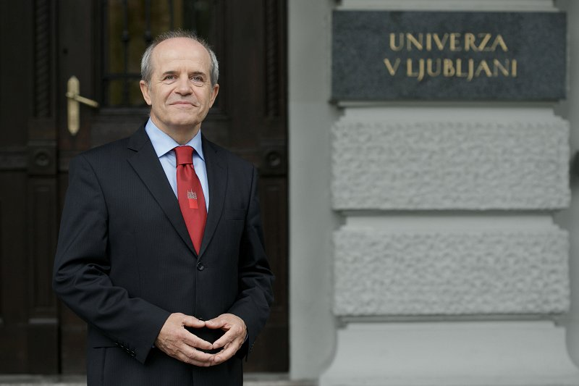
University of Ljubljana
Rector: Prof. Dr. Ivan Svetlik

Slide 4
University of Ljubljana: members
Biotechnical Faculty
Faculty of Economics
Faculty of Architecture
Faculty of Social Sciences
Faculty of Electrical Engineering
Faculty of Pharmacy
Faculty of Civil and Geodetic Engineering
Faculty of Chemistry and Chemical Engineering
Faculty of Mathematics and Physics
Faculty of Maritime Studies and Transport
Faculty of Computer Science and Informatics
Faculty of Social Work
Faculty of Mechanical Engineering
Faculty of Sports
Faculty of Administration
Faculty of Arts
Faculty of Medicine
Faculty of natural Sciences and Engineering
Faculty of Education
Faculty of Veterinary Medicine
Faculty of Theology
Faculty of Law
Faculty of Health Science
Academy of Music
Academy of Theatre, Radio, Film and Television
Academy of Fine Arts and Design
23 faculties and 3 academies

Slide 5
Study at the University of Ljubljana
Members of the University of Ljubljana offer the total of 417 study programs:
32 1st cycle higher education professional study programs
128 1st cycle academic study programs
7 uniform master study programs
216 2nd cycle master study programs
14 2nd cycle joint master study programs
20 3rd cycle doctoral study programs

Slide 6
Research activities
Currently, the researchers of the University of Ljubljana are involved in:
175 research programs
About 300 basic and applied research projects
more than 750 European projects
Since 2006, we rank among 500 best universities in the world according to ARWU (Academic Ranking of World Universities – “Shanghai ladder”)
Criteria: SCI publication and citation record, number of papers in top scientific journal (Nature, Science), number of Nobel laureates, ...

Slide 7
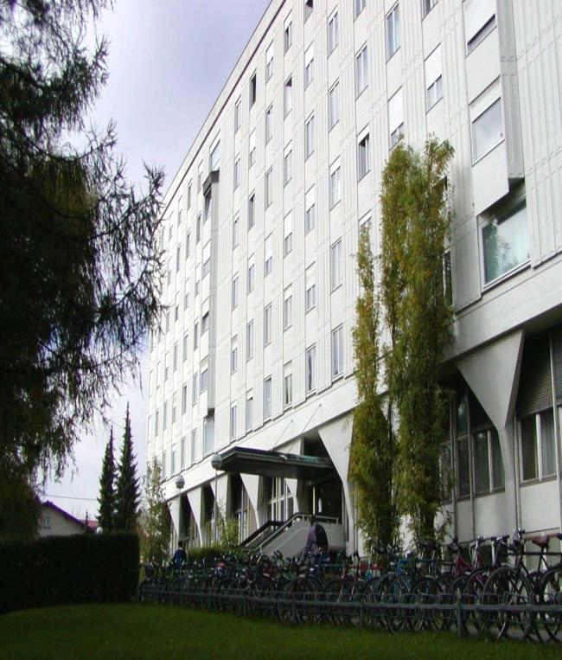
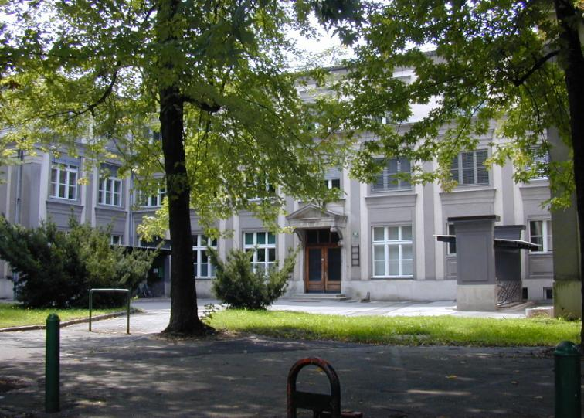
2 locations:
main building (with laboratory for structures and materials)
environmental engineering with laboratory
Dean: Prof. Dr. Matjaž Mikoš

Slide 8
Faculty in numbers
Study programs (2015/2016)
5 undergraduate programs-B1
5 graduate programs-B2
2 doctoral programs-B3
Employees (2016)
219 in total
92 academic staff
Students (2015/2016)
891 regular undergraduate students
66 graduate students

Slide 9
Faculty of Civil and Geodetic Engineering
Study programs:
1st Cycle:
Civil Engineering
Construction Management
Water Science and Environmental Engineering
Geodesy and Geoinformation
Technical Real Estate Management
2nd Cycle:
Civil Engineering
Water Science and Environmental Engineering
Geodesy and Geoinformation
Spatial Planning
Buildings
3rd Cycle:
Built Environment
Environmental Protection

Slide 10
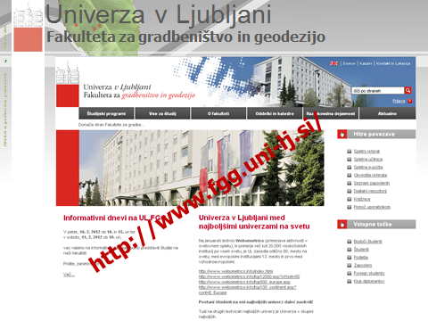
Faculty of Civil and Geodetic Engineering

Slide 11
Instructions for incoming students
Upon arrival contact International Office – Ms. Romana Hudin, Faculty of Civil and Geodetic Engineering, room P-3 (ground floor), Jamova 2, 1000 Ljubljana (romana.hudin@fgg.uni-lj.si )
According to your Learning Agreement you will receive information about responsible teachers of individual courses.

Slide 12
Instructions for incoming students
You should contact the teachers within one week after arrival. They will define your obligations, study literature, seminar work, etc.
If you wish to change your Learning Agreement, discuss the changes with adequate teachers and bring the form Changes to Original Learning Agreement to International Office.

Slide 13
Instructions for incoming students
For each exam that you pass, professors will issue a signed certificate with adequate grade. In order to be issued the final Transcript of Records, you should bring these certificates to International Office.
You should finish all the defined obligations and exams before you leave and go back home. It is not allowed to make exams from your home institution.

Slide 14
Instructions for incoming students
UL FGG provides access to the Eduroam WiFi network. In order to use it, ensure beforehand that you are able to use Eduroam when still at your home institution.
Digital Identity: To activate your DI as student of University of Ljubljana, go to: https://id.uni-lj.si/index.php?lang=en_US&action=idportal
For any further information, please contact International Office, Ms. Romana Hudin or Erasmus Coordinator Prof. Dušan Petrovič (dusan.petrovic@fgg.uni-lj.si).

Slide 15
Meet our student tutors
Student tutors for foreign students are there to help you get around the faculty and with any study problems.
In the academic year 2015/2016 they are:
Uroš Jotanović, Civil Engineering (jotanovic.uros@gmail.com)
Danijel Georgijev, Civil Engineering (danijelgeorgijev94@gmail.com)
Filip Franc, Civil Engineering (franc_filip@hotmail.com)
Barbara Fröhlich, Geodesy (barbyfrelih@gmail.com)
Dora Kovač, Buildings (dorakovac3@gmail.com)
Maja Klenovšek, Environmental Eng. (maja.klenovsek@gmail.com)
Katja Ogrin, Civil Engineering (katjaogrind3@gmail.com)

Slide 16
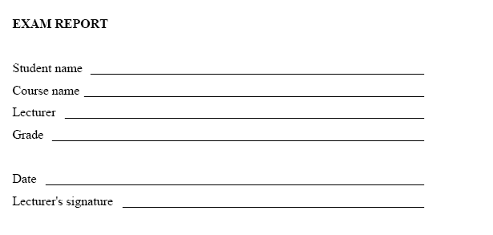
Exam Report

Slide 17
Personal ID numbers
All foreign students receive Personal ID number issued by the Ministry of Internal Affairs. It is necessary e.g. to get monthly bus ticket, food coupons, etc.

Slide 18

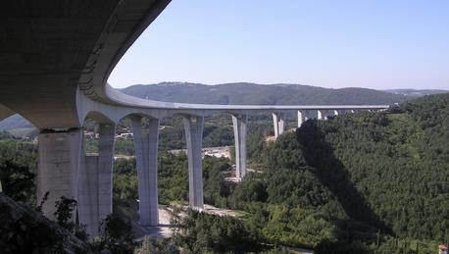
Thank you for your attention!
COMMENTS, QUESTIONS ???

